Slide 1
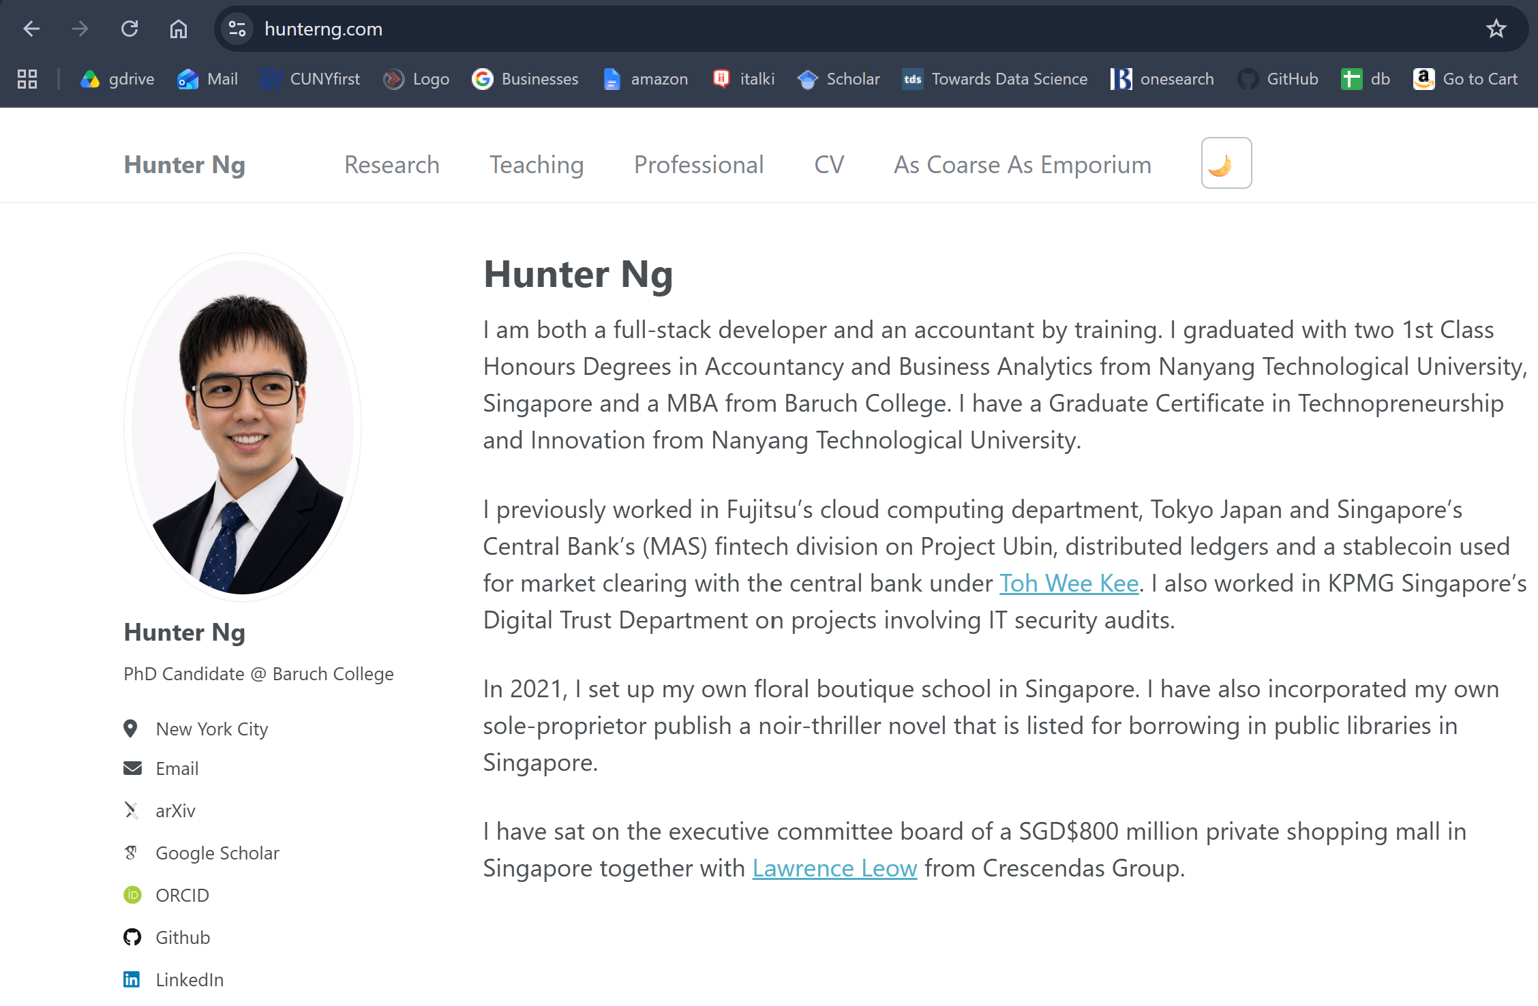


Slide 2
FS AUDITOR
FLORIST
IT AUDITOR
CENTRAL BANK ANALYST
ASSISTANT TO CHAIRMAN OF RICH PEOPLES’ SOCIAL CLUB
CLOUD SOLUTION ANALYST
ACCOUNTING RESEARCHER

Slide 3
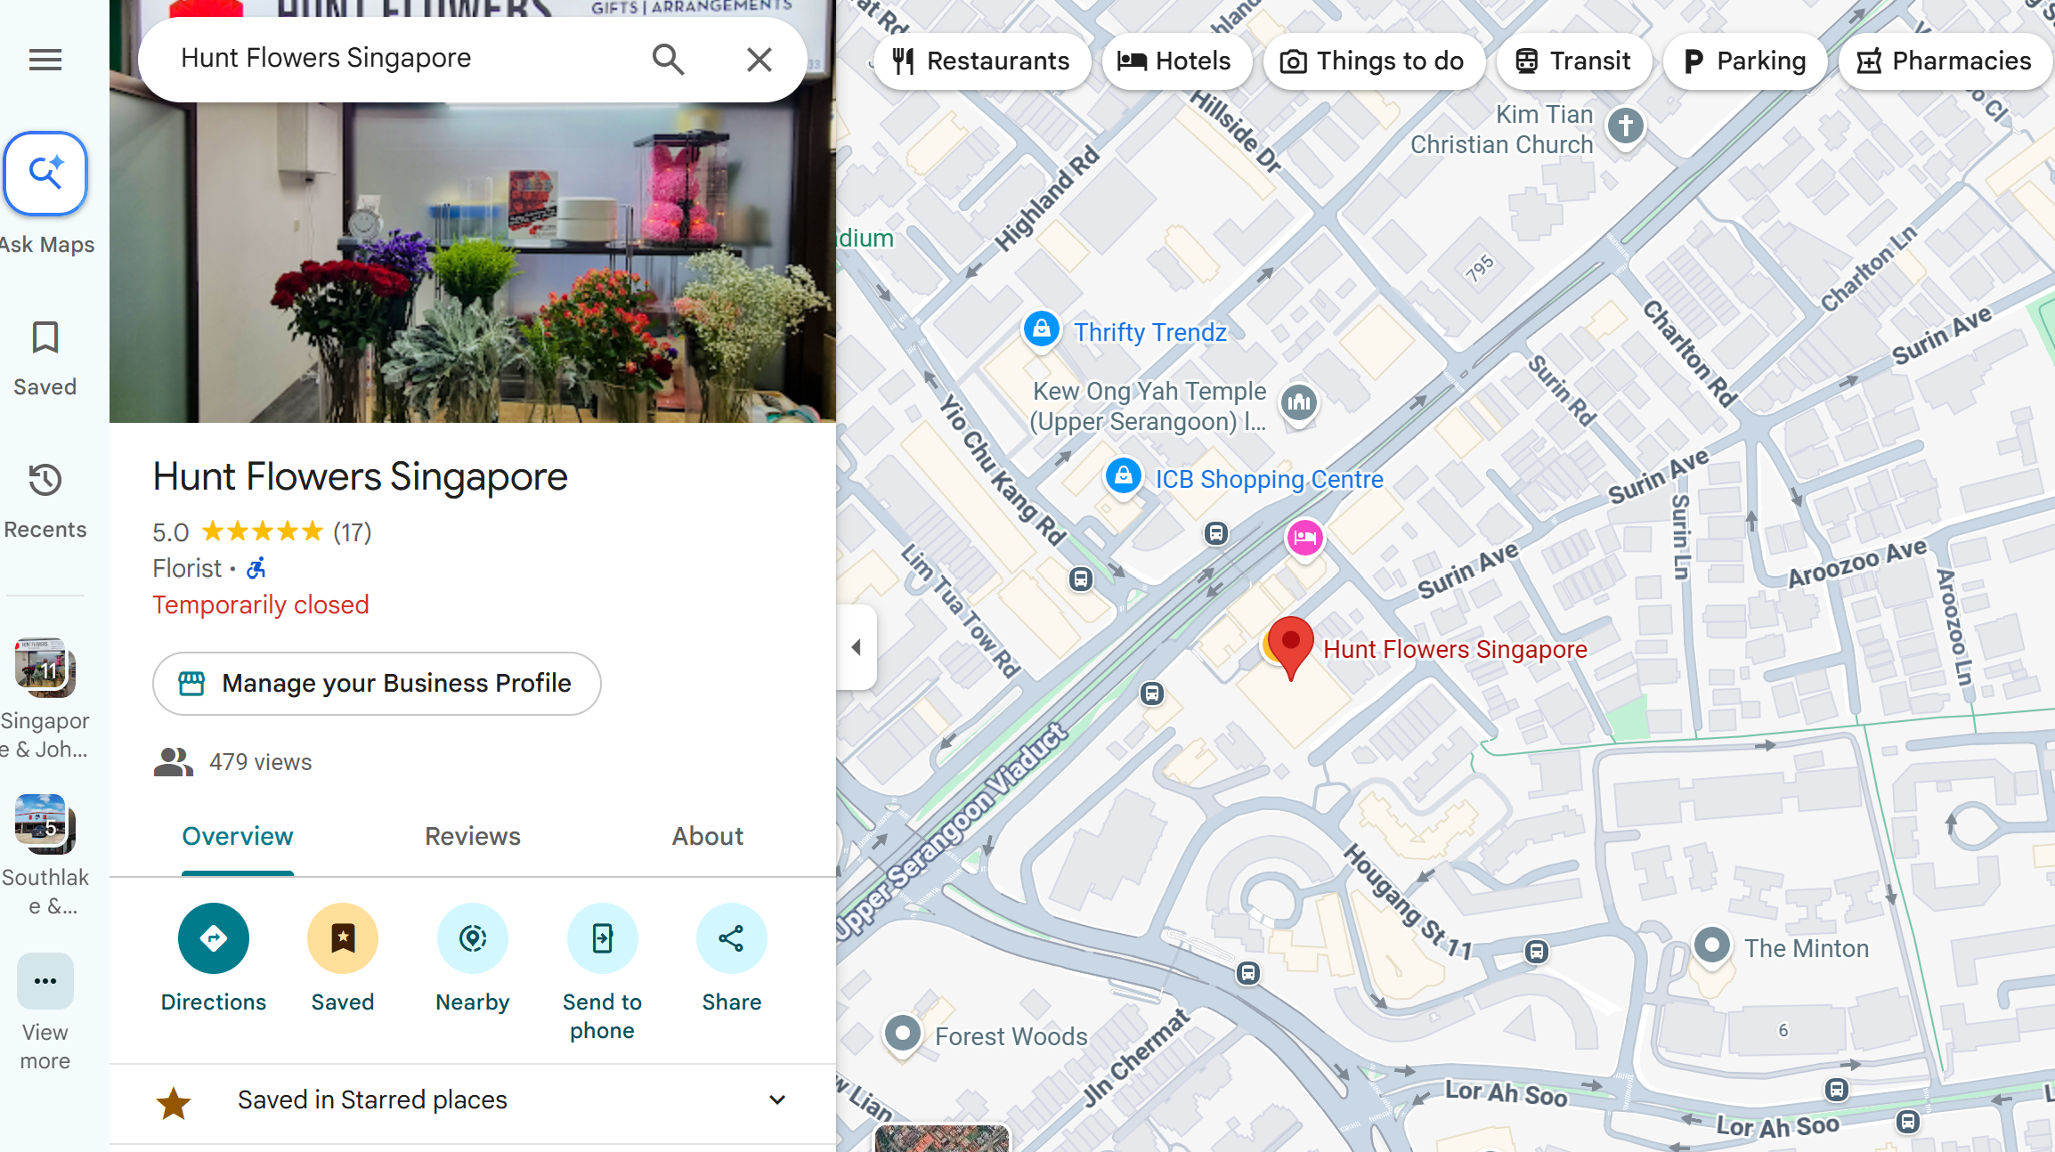
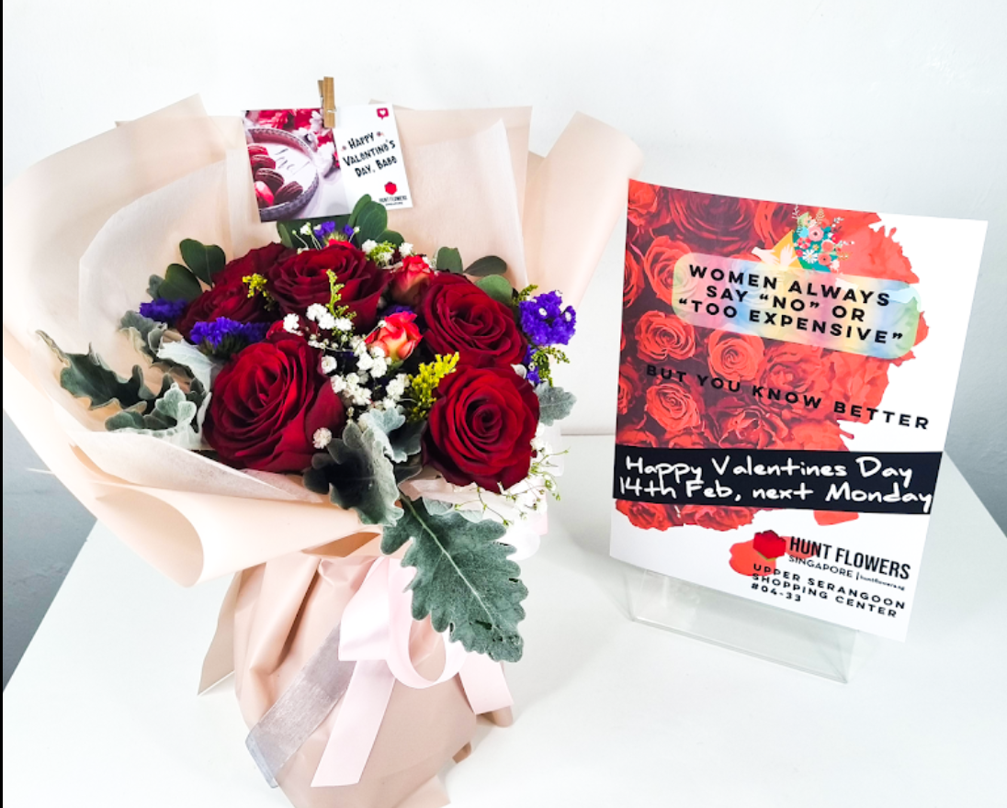

Slide 4
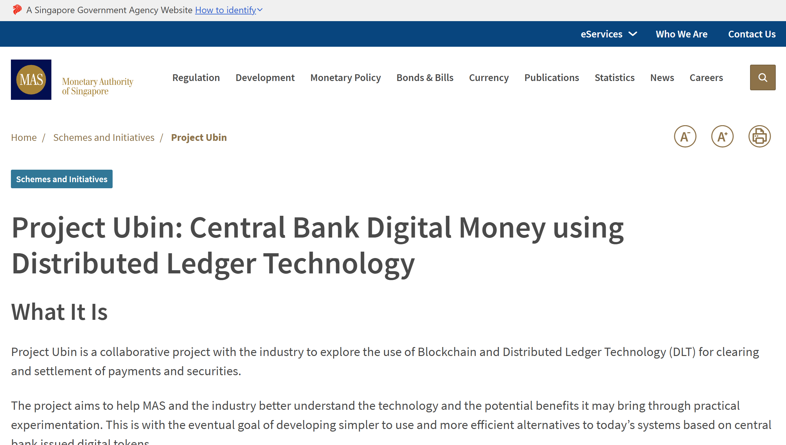
STORY

Slide 5
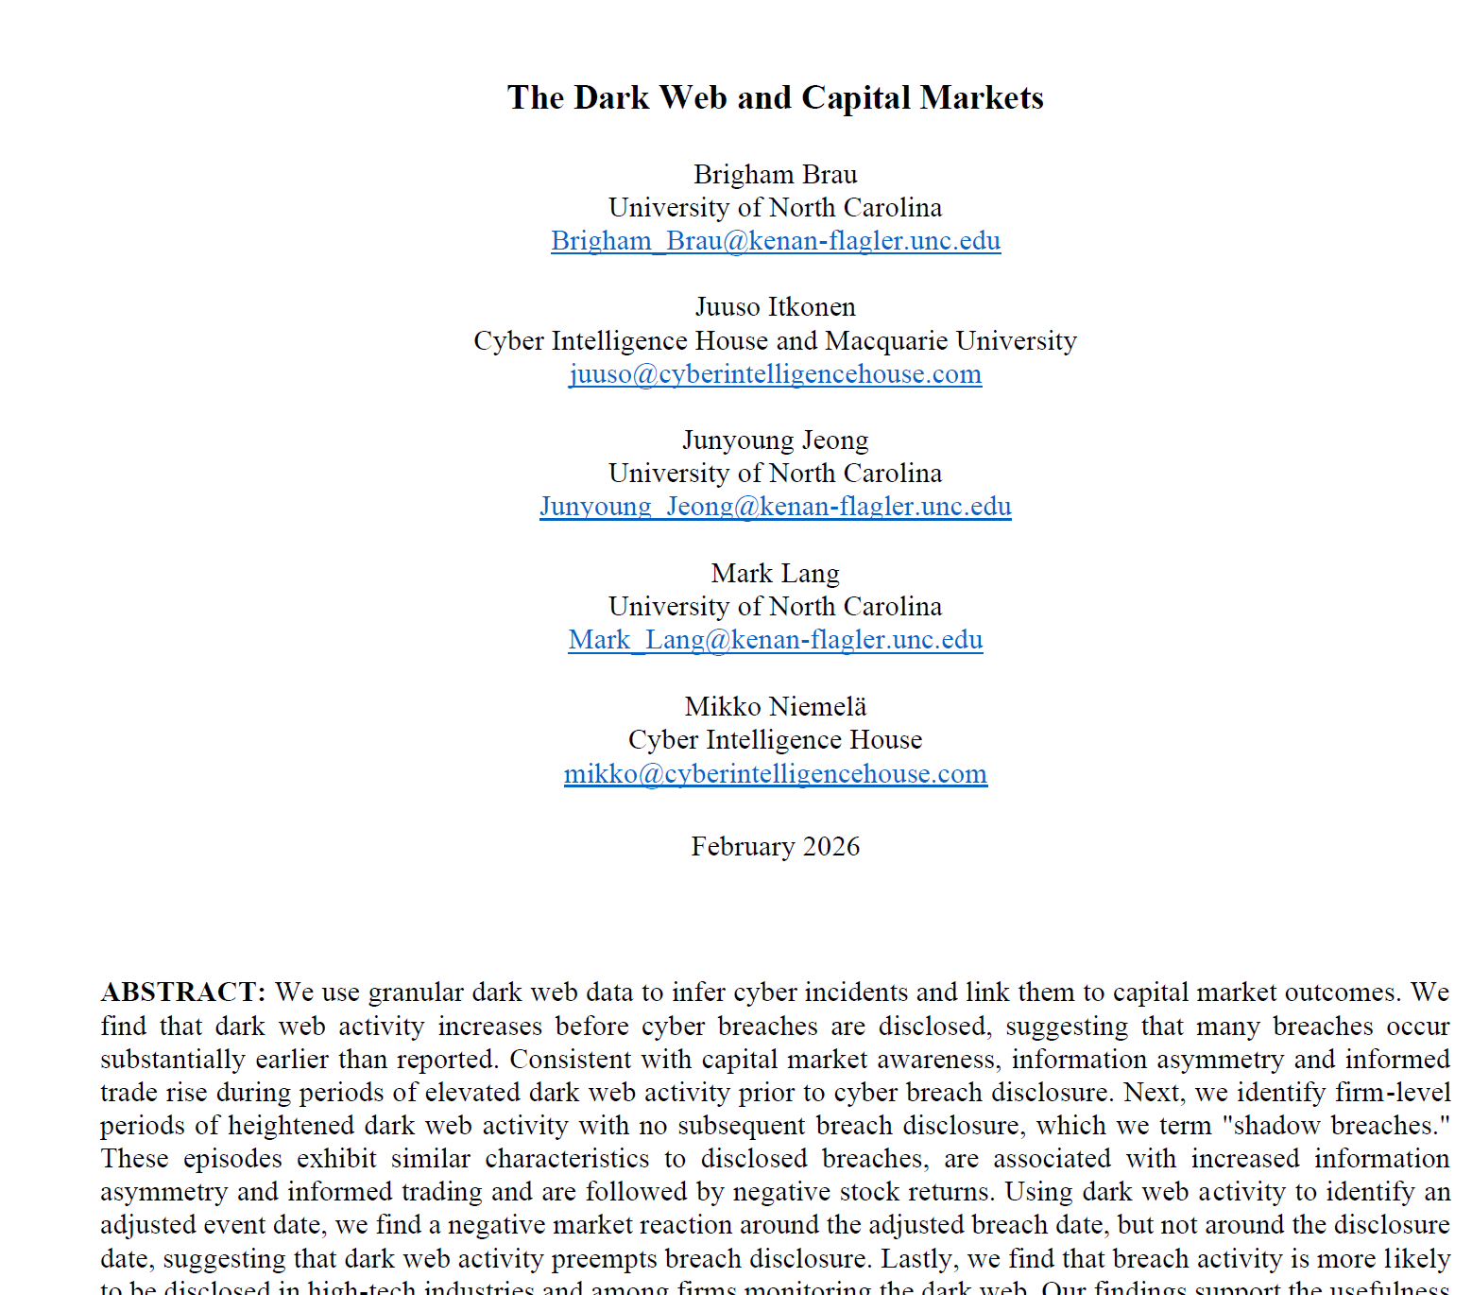
STORY

Slide 6
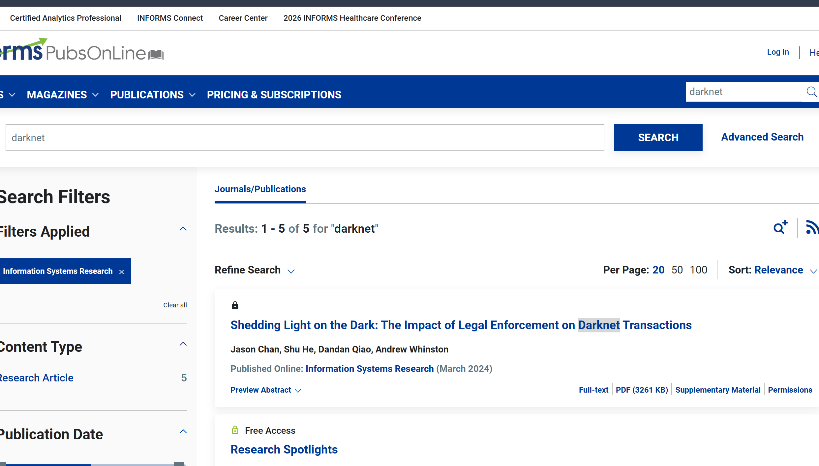
STORY

Slide 7
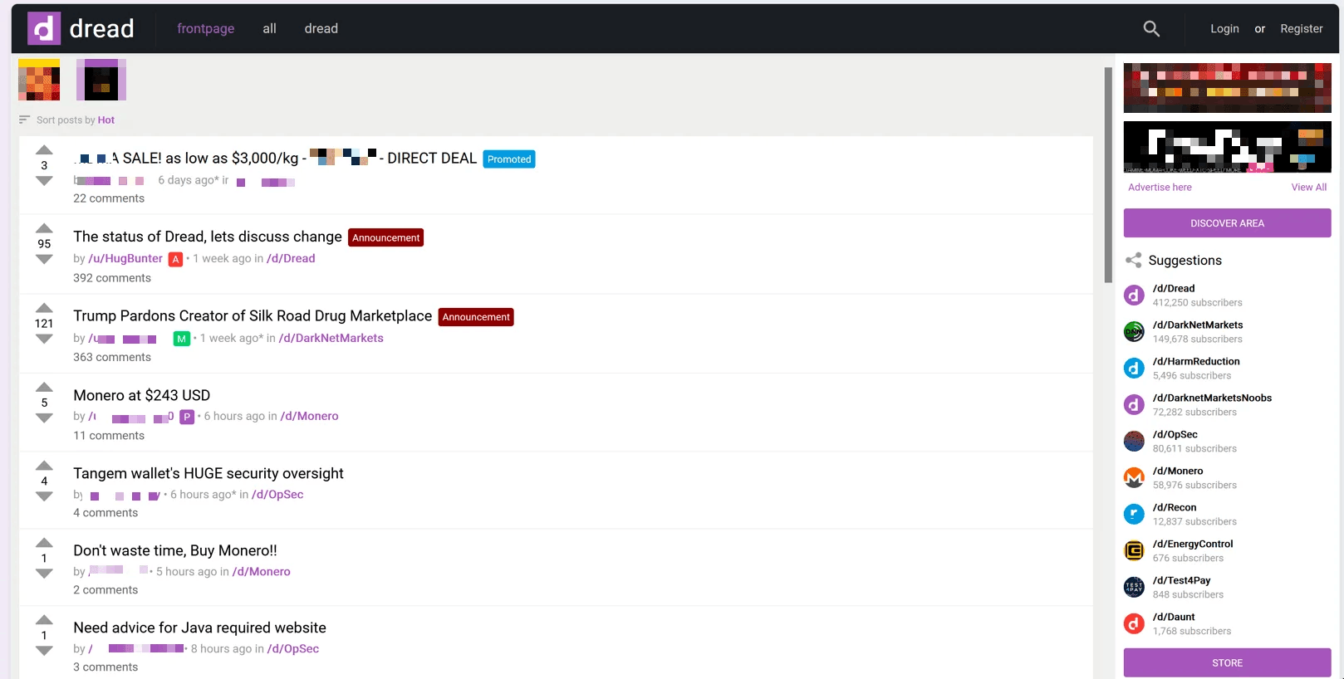
STORY

Slide 8
LAWLESS
TRUSTLESS
PRIVATE-ORDER
La Porta et al., 1997 – Legal Determinants of external finance (JF)
Arrow, 1972 - Gifts and Exchanges, (PPE)
Donohue and Levitt, 1998 – Guns, violence, and the efficiency of illegal markets (AER)
DECENTRALIZED MARKETS
CENTRALIZED MARKETS
Rostek and Yoon, 2025 – Financial product design in decentralized markets (JPE)
Chan et al., 2024 – Shedding light on the dark (ISR)
ILLEGAL GOODS
Darknet Markets
Becker et al., 2006 – The market for illegal goods: the case of drugs (JPE)
How do transactions even occur?

Slide 9
HOW does trade occur when formal institutions are absent?
Repeated Cooperation
Private-order enforcement (trading network, gossip, reputation)
Private violence or retaliation
Escrows
What is the market equilibrium design of darknet markets?
What is the optimal form of escrow in trustless markets?

Slide 10
WHY IS THIS IMPORTANT?
Characterizing how trustless trades take place on darknet
Characterizing market design equilibrium of darknet
Optimal escrows are good-specific
Help our understanding in settings with weak governance

Slide 11
HOW?
MODEL
ARCHIVAL

Slide 12
TRUST DESIGN
(TIMING / STRENGTH)
MARKETPLACE DESIGN
PRODUCT FEATURE
ESCROW USED
ESCROW /
REPUTATION
CENTRALIZED VS DECENTRALIZED
ESCROW DESIGN
TYPE OF ESCROW USED / % COMM

Slide 13
We are offering KYC Verifications legally handmade for many accounts and Openbullet Configs for your needs. Prices ranges between $20 and $200 for all of these accounts, so just ask me about the price and I will reply! Negotiable, looking to do cheap prices of all of these. I'm doing also CUSTOM verifications for other platforms or apps. Crypto Accounts: Paxful AlchemyPay Bit2Me Coinbase Moonpay Noones Kraken Kucoin Paybis Binance Bybit Nexo Cex.io Huobi Wallets & Banks Accounts Skrill Pst.net Wirex Zen.com Lydia Paytend PaySafeCard WeststernCard Other Accounts *CENSORED* Every of this acount included ID back front selfie and the other documents used to verify it Mail access and phone access. I do accept escrow for any of these. If you re interested DM/PM me and I will reply in under 15 minutes! – 3rd Feb 2024
Escrow affords you some protection. DD offers the vendor protection. Not all markets are unstable. Sure Bohemia is having an issue but countless others are not. You should reveal the scammer's user name – 18th Dec 2023
So I met this guy on dread /u/Mudbrothers refered me to a guy who sells logs, the guy claims he used a bunch old dnm's in the past but doesn't anymore, his name is Expovendor on TG. He sells logs that are from Canada and US even if he lives in Canada but does not accept escrow because he did for 7 years and only does direct deals now, he offered: Bank Logins Balances $2-4K - $100 $5-10K - $150 $10-20K - $200 $30-50K - $250. https://dump.li/i/18ccee.jpeg https://dump.li/i/ba975d.jpeg https://dump.li/i/e594e3.jpeg https://dump.li/i/540043.jpeg Did anyone ever buy from this guy and is he legit? I don't want to get scammed. He also claimed he can walk me through step by step how to bypass 2fa and cashout. – 19th Dec 2025

Slide 14
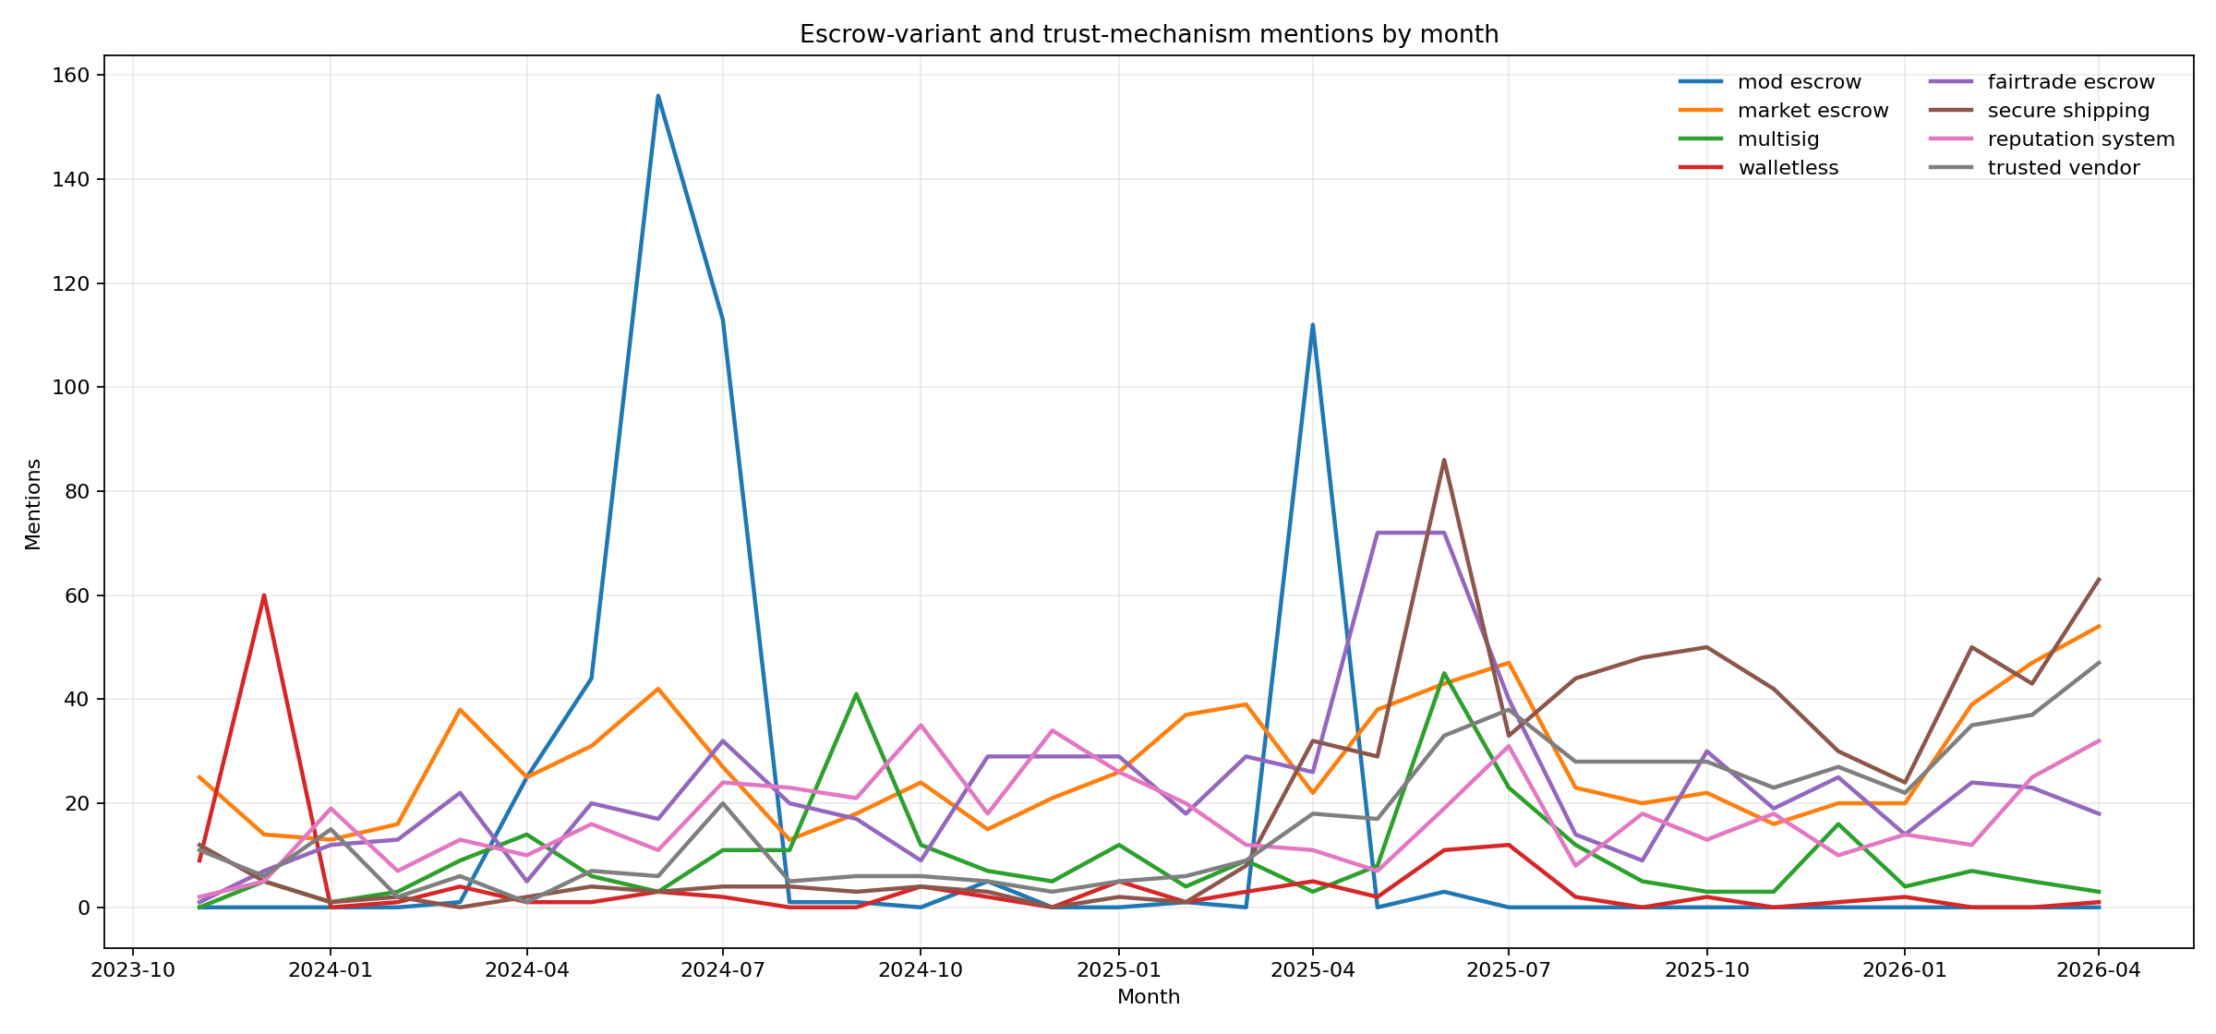

Slide 15
Thank you

